Slide 1

Lecture 7 DBMS Structure (Components And Overall Structure of DBMS)
Dr. Sanjeev Kumar
Asst. Professor

Slide 2
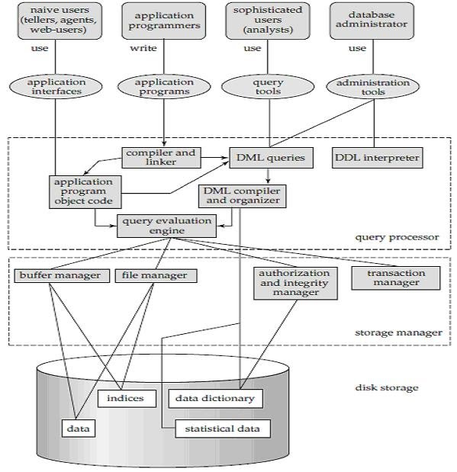

Slide 3
Components of DBMS
Database Users:
Naïve Users, Application Programmer, Sophisticated Users, DBA
2. Query Processor :
(a) DML Compiler (b) Embedded DML pre-compiler (c) DDL Interpreter (d) Query Evaluation Engine
3. Storage Manager :
(a) Authorization and Integrity Manager (b) Transaction Manager (c) File Manager (d) Buffer Manager

Slide 4
Components of DBMS
4. Data Structure : (a) Data Files (b) Data Dictionary (c) Indices (d) Statistical Data

Slide 5
Database Users
Naïve users :
Naive users are unsophisticated users who interact with the system by invoking one of the application programs that have been written by programmer.
For example, a bank teller who needs to transfer $50 from account A to account B invokes a program called transfer. This program asks the teller for the amount of money to be transferred, the account from which the money is to be transferred, and the account to which the money is to be transferred.

Slide 6
Application programmers :Application programmers are computer professionals who write application programs. Application programmers can choose from many tools to develop user interfaces.
Sophisticated users:
Sophisticated users interact with the system without writing programs. Instead, they form their requests in a database query language.
They submit each such query to a query processor, whose function is to break down DML statements into instructions that the storage manager understands.

Slide 7
Database Administrator:
Coordinates all the activities of the database system.
Database administrator's duties include:
Schema definition
Storage structure and access method definition.
Schema and physical organization modification:
Granting user authority to access the database:
Specifying integrity constraints.
Monitoring performance and responding to changes in requirements

Slide 8
Query Processor Components :
The query processor will accept query from user and solves it by accessing the database.
DML Pre-compiler : It translates DML statements in a query language into low level instructions that query evaluation engine understands. It also attempts to transform user's request into an equivalent but more efficient form.
Embedded DML Pre-compiler : It converts DML statements embedded in an application program to normal procedure calls in the host language. The Pre-compiler must interact with the DML compiler to generate the appropriate code.

Slide 9
Query Processor Components
DDL Interpreter : It interprets the DDL statements and records them in a set of tables containing meta data or data dictionary.
Query Evaluation Engine : It executes low-level instructions generated by the DML compiler.

Slide 10
Storage Manager Components :
They provide the interface between the low-level data stored in the database and application programs and queries submitted to the system.
• Authorization and Integrity Manager : It tests for the satisfaction of integrity constraints checks the authority of users to access data. • Transaction Manager : It ensures that the database remains in a consistent state despite the system failures and that concurrent transaction execution proceeds without conflicting.

Slide 11
Storage Manager Components :
File Manager : It manages the allocation of space on disk storage and the data structures used to represent information stored on disk. • Buffer Manager : It is responsible for fetching data from disk storage into main memory and deciding what data to cache in memory.

Slide 12
Data Structures :
Following data structures are required as a part of the physical system implementation.
• Data Files : It stores the database. • Data Dictionary : It stores meta data (data about data) about the structure of the database. • Indices : Provide fast access to data items that hold particular values. • Statistical Data : It stores statistical information about the data in the database. This information is used by query processor to select efficient ways to execute query.

